Slide 1

Intro to TypeScript
07/25/2016

Slide 2

Agenda
What is it?
Features
What does it look like?
Demo
Questions
Tools and Resources

Slide 3
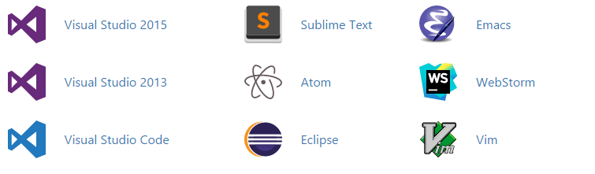
What is it? (And why should I care???)
Superset of JavaScript
Doesn’t try to replace it – just enhances it
Transcompiles into JavaScript
JavaScript WITH Intellisense
Developed and supported by Microsoft
Large amount of support from popular IDEs:
Notes:
TypeScript is a superset of JavaScript. It transcompiles into JavaScript and doesn’t seek to replace JavaScript, only to make it better through modern ECMAScript features. It was developed by Microsoft and released to the public on October 1, 2012 at version 0.8. On its initial release the language itself was praised but there was no IDE support other than Visual Studio. This was shortly changed as more IDEs hopped on bandwagon and found ways to support TypeScript, including Microsoft with their release of Visual Studio Code that is lightweight and usable on any OS. Some other popular IDEs that have incorporated TypeScript are listed here.

Slide 4
Features
Utilize classes
Arrow function syntax
Optional parameters
Find errors in development, not in testing
Compile-Time type checking
Intellisense error reporting
Namespaces
Asynch/Await
Interfaces
Type inference
Notes:
First three – now features in ECMAScript 6, has been a feature in TypeScript for a long while. Error stuff speaks for itself.

Slide 5
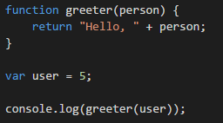
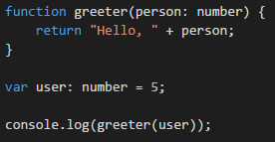
What does it look like?
JavaScript
TypeScript
Notes:
What does TypeScript look like? Well, it looks very similar to JavaScript if you’ve worked with that in the past. Main difference is the typing associated that allows for real-time error detection.

Slide 6
Demo
Notes:
Start off showing them how to install Visual Studio Code and NodeJS (refresher from last LnL). After installing NodeJS, show them how you must modify the registry in the configuration in order to load over http instead of https. Run npm install –g typescript. TypeScript 1.8.10 will be installed.

Slide 7
Questions?

Slide 8
Tools & Resources
TypeScript Homepage– https://www.typescriptlang.org/
TypEcs (Eclipse support) - http://typecsdev.com/
TypeScript on NPM - https://www.npmjs.com/package/typescript

